Slide 1
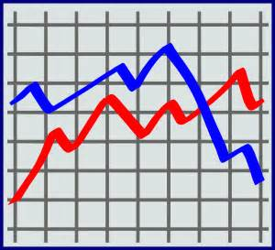
ACT Preparation for Science Reasoning
C. RAY- ACT PREP

Slide 2
Science Reasoning
Don’t let it SCARE you…..
You don’t need to know very much information about the topics which includes Biology, Chemistry, Physics, Meteorology, Geology, and Astronomy.
You need to FOCUS on reading Carefully and Thinking Logically.
Everything you need to know in order to answer the questions will be given to you in the passages.

Slide 3
Science Reasoning
Is not testing knowledge of scientific facts
Is testing your ability to solve puzzles, read graphs and charts, draw conclusions and inferences by working with facts, evidence, and data.

Slide 4
Science Reasoning
40
Multiple Choice
Questions divided
Into 7 passages
2 or 3
Data Representation
3 or 4
Research
Summaries
1
Conflicting
Viewpoint

Slide 5
Science Reasoning
Three types of questions:
Understanding: tests your ability to know what the passage is saying
Analysis: asks you to find the deeper meanings in the passage
Generalization: Inferences

Slide 6
Science Reasoning
 | Data representation | Research Summaries | Conflicting Hypotheses
Understanding (about 2 questions) | Knowing the variables and their values | Identify the problem and the data | Knowing the points at issue
Analysis (about 3 questions) | How they relate and what is implied by relationship | Conclude from data compared to controls | Does arguments agree with facts
Generalization | Suggests further study from data | How results impact society | What study implies for others not in study

Slide 7
You have 35 minutes
To read 7 passages, look at charts and graphs, and answer 40 questions…..
That is 5 minutes per passage and obviously less than a minute per question..
HOW??

Slide 8
Test Taking Strategies
Start by scanning the passage. This should take no more than 20 seconds. Just get a “rough” idea of what it is about. Do not study DETAILS. Look for the MAIN message of the graph/ chart.
Read the passage again in order to really understand it. Underline any key words.

Slide 9
Test Taking Strategies
3. Answer the first question in the group. It is an understanding question (the simplest of the 3 types).
If you can’t answer it, you’ll probably miss the rest too. Look back in the passage to find the answer.
If you still can’t answer it, skip to the next passage and come back to this
one later.

Slide 10
Test Taking Strategies
Skip the hard questions.
After you have answered the first question.
Do not spend more than 30 seconds on any question.
Every question is worth the same number of points….go for the easy ones first…
BUT…never leave a question blank even if you take a guess

Slide 11
Test Taking Strategies
Read all the choices.
Choosing the right answer is eliminating the three wrong answers..
Process of elimination (P.O.E.)- cross off incorrect answers as you go; this will decrease the number of choices when you aren’t sure of the answer

Slide 12
Test Taking Strategies
Use Estimation when asked to calculate.
You can also use
process of
elimination.

Slide 13
Test Taking Strategies
Pace yourself.
35 minutes for
7 passages
5 minutes per passage
You have about 30 seconds for each question.

Slide 14
Test Taking Strategies
Answer every question.
When you answer the easy questions, try the hard ones again without spending too much time.
When your time is running out with only a 30 seconds or so left, pick a “Letter of the Day "on the answer sheet.

Slide 15
Difficulty of the questions
For each passage, after you have scanned and then read it….answer the first one. If it is too hard even after looking for the answer, skip to the next passage.
When you answer the first question, read through all of the questions answering the easiest “understanding” questions first.

Slide 16
Difficulty of the questions
Never leave a question blank before you move on to the next passage
There is no penalty for guessing
It is difficult to come back to a question once you start a new passage because you’ll need to reacquaint yourself with the passage. It is better to at least take a guess the first time through.

Slide 17
Data Representation
Includes information (data) presented on some sort of chart or graph
You will analyze the data
in order to answer the questions.
You must understand what the variables are.
Pay attention to chart notes, which will provide essential information that you need to interpret the data in the chart or graph.

Slide 18
Data Representation
A little background knowledge
will be helpful here.
Variable – what changes in an experiment
Independent variable – what the experiment is changing
Dependent variable – the change being measured as the independent variable changes

Slide 19
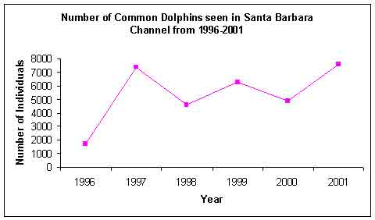
Data Representation
Line graphs show how something changes (usually over time)
Useful for identifying increases or decreases in data
Look for main
message of graph
Watch for changes
over time.
Be aware of the relationship between the variables.

Slide 20
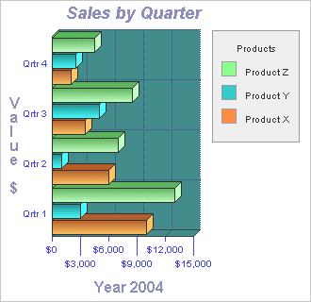
Data Representation
Bar graphs – used to show similarities and differences between data sets.
Can be set up horizontally or vertically
A scale is used to show comparisons
Look for main message
through the trend
in the graph

Slide 21
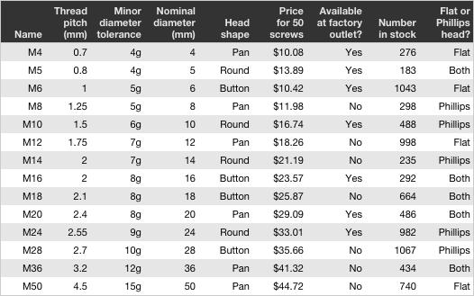
Data Representation
Tables – show exact values
Can be used to show quantitative(numbers) data
And Qualitative data such as characteristics
Try to identify the relationships between data sets

Slide 22
Data Representation
Ask yourself these four questions:
What are the units of measure?
What are the values of the variables?
Are there any trends?
Are there any correlations?

Slide 23
Data Representation
Do you remember the metric system?
Kilo, hecta, Deka, base unit, deci, centi, milli
Make sure you know what measurement the chart or graph is using…question may require you to convert.
On a graph the x axis is usually the independent variable and the y axis is the dependent variable.
Direct and indirect correlation?
Inversely proportionate?

Slide 24
Research Summaries
Thinking like a scientist:
Requires following a pattern of thinking called the scientific method. If you understand this method, you will have more success on the research summaries portion of the test.
There are no test questions specific to the scientific method, but having an understanding of the process will help you answer the questions correctly.

Slide 25
Research Summaries
State the problem
Research (gather information)
Form a hypothesis (an educated guess)
Perform an experiment. (control and variable set up)
Record and analyze Data
State a conclusion. – does not always agree with hypothesis
Repeat the process.

Slide 26
Research Summaries
Form a hypothesis (an educated guess)
made before experiment is performed
Experiment – must be at least 2 set ups:
Control – does not include what is being tested
Experimental – includes variable that is being tested

Slide 27
Research Summaries
The results obtained from the experiment must prove or disprove the hypothesis.
Rules for most experiments:
Most experiments require a control group
An experiment should not test more than one variable at a time.
An experiment should be unbiased.
4. Only the data from the experiment should be used to make the conclusion.

Slide 28
Research Summaries
What is a control?
Why must there be a control group?
What is a variable?
How many variables can be tested in an experiment?

Slide 29
Research Summaries
What is a control? An individual or a group participating in an experiment under the same conditions as another group except for the exclusion of one factor
Why must there be a control group?
To serve as the standard; to have something to compare the experimental group

Slide 30
Research Summaries
What is a variable? The changes in an experiment; what is being tested.
Independent – causes another value or characteristic to change when it is changed
Dependent – the value that changes due to a change in the independent variable
How many variables can be tested in an experiment? One

Slide 31
Research Summaries
Hypothesis: Plants grow better in the dark.
Control group: plant in normal light conditions
Experimental group: everything about this setup the same as control except it is placed in the dark.
The control group is needed to make the comparison.
What is the independent variable?
What is the dependent variable?

Slide 32
Research Summaries
Let’s practice determining independent and dependent variables.

Slide 33
Research Summaries Understand the problem
Each description starts with a statement of what the experiment is designed to explore.
READ THIS STATEMENT CAREFULLY; Make sure you understand this statement.

Slide 34
Research Summaries Understand the design
Study the design of the experiment.
Underline key words in the description. If there isn’t a diagram, sketch yourself one.

Slide 35
Two experimental designs:
Research of some aspect of natural world – making measurements of some kind; relationship between variables; You should identify the variables.
Example: global warming and effect on polar ice
(temperature vs
rate of melting)

Slide 36
Experiments in which the independent variable is being controlled or adjusted, which will make the dependent variable change.
You must
understand the variables.

Slide 37
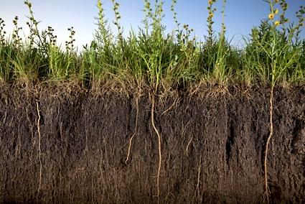
Research Summaries
Understand the controls:
Precautions taken to eliminate all variables except the independent variable….
Plants must have identical soil, air, water…..
Must be genetically identical, etc

Slide 38
Research Summaries
Study the results-
May be presented in words, a diagram, or in some form of a data table (independent variable on left, dependent variable on right)
Look for trends….

Slide 39
Research Summaries
Look for flaws such as:
Are the controls adequate?
Is the conclusion obvious by looking at the data?
Are there errors in the experiment?

Slide 40
IN 35 MINUTES which is 5 minutes per passage

Slide 41
Conflicting Viewpoints
Science ideas and theories are incomplete and are constantly being modified…..
Therefore, there are
disagreements, which lead to
Research, investigations, and experimentation.
Eventually, a consensus will be reached
due to the data and evidence
obtained through experimentation.

Slide 42
Conflicting Hypotheses
This type of passage gives:
a brief summary or description of the problem
Explanations of the two conflicting viewpoints of the scientist

Slide 43
Conflicting Hypotheses
This passage takes more time and should be saved for last.
Is usually the most difficult!

Slide 44
Conflicting Hypotheses
Asks you to compare varied opinions about a scientific topic and to evaluate different hypotheses based on scientific data.
Trying to decide which hypothesis is correct is a waste of time.
The test does not ask you to choose the right one.

Slide 45
Conflicting Hypotheses
This passage discusses a scientific topic which is explained by more than one hypothesis.
The 2 hypotheses directly contradict each other. However, they may have some similarities.
Never mix up the hypotheses.
They may have same assumptions and use the same data to support their claims.

Slide 46
Conflicting Hypotheses
Think like a scientist
Must have a thorough understanding of the scientific method
Avoid making unnecessary assumptions
Read quickly and effectively as you go through the passage

Slide 47
Conflicting Hypotheses
Read the passage quickly
Identify the basic disagreement.
Think about these 6 questions:

Slide 48
Conflicting Hypotheses
What is the basic question that is argued?
What is the position of each scientist?
What is the evidence of Scientist I?
What is the evidence of Scientist 2?
What flaws does Scientist 2
find with Scientist 1?
What flaws does Scientist 1
find with Scientist 2?

Slide 49
Conflicting Hypotheses
Usually 7 questions:
Find similarities and differences
What observations would support or refute each hypothesis
You must understand what each hypothesis claims

Slide 50
Conflicting Hypotheses
General guidelines:
Identify the points where hypotheses agree and disagree
Look for evidence that supports each hypothesis
Think about what sort of new evidence would support or refute each hypothesis
Save it for last.

Slide 51
Conflicting Hypotheses
Save it for last.
If you are running out of time, look for the questions about only one of the passages.
Such as:
“The position taken by Scientist 1 involves the assumption that:”

Slide 52
Make sure when you practice you read the directions carefully. The directions will not change on test day.
Pace yourself.
Know which technique works best for you…are charts easier than graphs?

Slide 53
Conflicting Scientists
ACT Science Mini Lesson #11-Conflicting Scientists Practice
A greenish, potato-sized meteorite discovered in Antarctica is believed to have originated on Mars. Investigations of the meteorite have revealed a number of unusual features. Some scientists believe that these features are evidence of primitive life on Mars, while other scientists believe that they are more probably the result of nonbiological (nonliving) processes, such as hydrothermal synthesis.
Hydrothermal Synthesis Hypothesis
This hypothesis states that the meteorite crystallized slowly from magma (molten rock) on Mars 4.5 million years ago. About half a million years later, the rock became fractured. This was a time when Mars was much warmer and had abundant water. Deep inside the planet, in a process called hydrothermal synthesis, hot water and carbon seeped into the fractured rock and formed new complex organic compounds called polycyclic aromatic hydrocarbons (PAHs). (Organic compounds, or those that contain carbon, are formed from life processes, such as bacterial decay, as well as processes that are not associated with life, including hydrothermal synthesis and star formation.)
As the chemical environment of the planet changed over time, crystals of magnetite, iron sulfides, and carbonate formed in the rock. The crystallization of the carbonate resulted in the formation of unusual elongated and egg-shaped structures within the crystals.
Main Argument of Hypothesis #1 Hot water and carbon seeped into the fractured rock and formed new organic compounds called (PAHs).
Primitive Life Hypothesis
Proponents of this theory argue that the meteorite crystallized slowly from magma (molten rock) on Mars 4.5 million years ago. About half a million years later, the rock became fractured. At this time abundant water and a warm climate created the right conditions for life. The rock was immersed in water rich in carbon dioxide, which allowed carbon to collect inside the fractured rock, along with primitive bacteria. The bacteria began to manufacture magnetite and iron sulfide crystals, just as bacteria on Earth do. As generations of bacteria died and decayed, they created PAHs inside of the meteorite’s carbon molecules. Finally, some of bacteria themselves were preserved as elongated egg-shaped fossils inside the rock.
Main Argument of Hypothesis #2 The rock was immersed in water rich in carbon dioxide, which allowed carbon to collect inside the fractured rock. As generations of bacteria died and decayed, they created PAHs inside of the meteorite’s carbon molecules.

Slide 54
KEY POINTS
Key Points From the Passages on the Previous Slide
What is the issue being argued about? The issue being argued about is whether the features of the meteorite are evidence of primitive life on Mars, or if they are more probably the result of nonbiological (nonliving) processes, such as hydrothermal synthesis.
Main Point of Agreement The meteorite crystallized slowly from magma (molten rock) on Mars 4.5 million years ago. About half a million years later, the rock became fractured.
Main Point of Disagreement
Hydrothermal synthesis vs. primitive life

Slide 55
Good Luck!!

